Slide 1
CS3391 Object Oriented Programming
Dr.D.Sivaganesan, Professor, PSGiTech / CSE
Object Oriented Programming Dr.D.Sivaganesan and PSGiTech / CSE
1

Slide 2
throw keyword
The Java throw keyword is used to explicitly throw an exception.
We can throw either checked or unchecked exception in java by
throw keyword.
The throw keyword is mainly used to throw custom exception.
The syntax of java throw keyword is given below.
throw exception;
throw new exception_class("error message"); For example:
throw new ArithmeticException("dividing a number by 5 is not
allowed in this program");
Object Oriented Programming
Dr.D.Sivaganesan PSGiTech / CSE
2

Slide 3
public class exthrow{
static void validate(int age){ if(age<18)
throw new ArithmeticException("not valid"); else
System.out.println("welcome to vote");
}
public static void main(String args[]){ validate(16);
System.out.println("rest of the code...");
}
}
Object Oriented Programming
Dr.D.Sivaganesan and PSGiTech / CSE
3

Slide 4
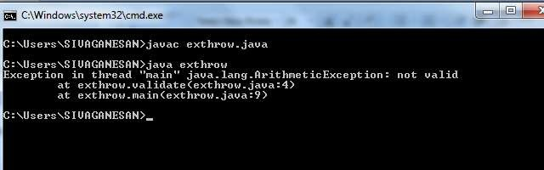
Object Oriented Programming
Dr.D.Sivaganesan and PSGiTech / CSE
4

Slide 5
throws Keyword
The throws keyword is used to declare the list of exception that a method may throw during execution of program.
Any method that is capable of causing exceptions must list all the exceptions possible during its execution, so that anyone calling that method gets a prior knowledge about which exceptions are to be handled.
A method can do so by using the throws keyword.
Syntax:
type method_name(parameter_list) throws exception_list
{ // definition of method
}
Object Oriented Programming
Dr.D.Sivaganesan and PSGiTech / CSE
5

Slide 6
public class exthrows
{
static void divide(int a,int b) throws ArithmeticException,ArrayIndexOutOfBoundsException
{
int c=a/b;
System.out.println("Division result :"+c);
int arr[] = new int[7];
arr[10] = 5; // accessing 10th element in an array of size 7
}
public static void main(String args[])
{
try
{
divide(25,10);
}
catch(ArithmeticException|ArrayIndexOutOfBoundsException e)
{
System.out.println(e);
} } }
Object Oriented Programming
Dr.D.Sivaganesan and PSGiTech / CSE
6

Slide 7
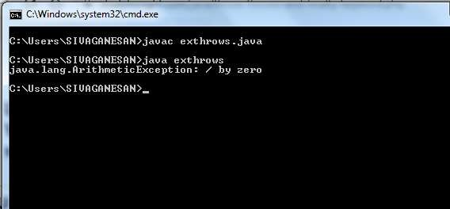
Object Oriented Programming
Dr.D.Sivaganesan PSGiTech / CSE
7

Slide 8
Difference between throw and throws
throw | throws
throw keyword is used to throw an exception explicitly. | throws keyword is used to declare an exception possible during its execution.
throw keyword is followed by an instance of Throwable class or one of its sub-classes. | throws keyword is followed by one or more Exception class names separated by commas.
throw keyword is declared inside a method body. | throws keyword is used with method signature (method declaration).
We cannot throw multiple exceptions using throw keyword. | We can declare multiple exceptions (separated by commas) using throws keyword.
Object Oriented Programming
Dr.D.Sivaganesan and PSGiTech / CSE
8

Slide 9
User defined (or)Custom Exception
If you are creating your own Exception that is known as custom exception or
user-defined exception, which are basically derived classes of Exception.
Java custom exceptions are used to customize the exception according to user
need.
By the help of custom exception, you can have your own exception and
message.
Syntax
class ownexception extends Exception
{
}
try
{ …. throw new ownexception(“msg”); } catch (ownexception obj)
{ ….}
Object Oriented Programming
Dr.D.Sivaganesan and PSGiTech / CSE
9

Slide 10
class own extends Exception
{
own()
{
System.out.println("Number is too small");
}}
class exown
{
public static void main(String args[])
{
try
{
int x=5,y=1000;
if(x<y)
{
throw new own();
}}
catch(own e)
{
System.out.println(e); }}}
Object Oriented Programming Dr.D.Sivaganesan PSGiTech /
CSE
10

Slide 11
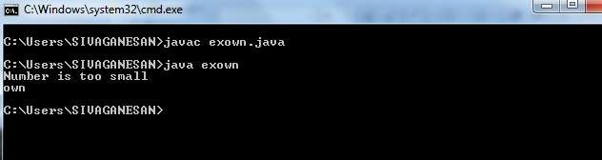
Object Oriented Programming
Dr.D.Sivaganesan and PSGiTech / CSE

Slide 12
assert keyword
Assertion is a statement in Java which ensures the correctness of any assumptions which have been done in the program. When an assertion is executed, it is assumed to be true. If the assertion is false, the JVM will throw an Assertion error.
It finds it application primarily in the testing purposes.
Assertion statements are used along with boolean expressions.
Assertions in Java can be done with the help of the assert keyword. There are two ways in which an assert statement can be used.
First Way −
assert expression;
Second Way −
assert expression1 : expression2
By default, assertions are disabled in Java. In order to enable them we use the following command −
java –ea classname (or) java -enableassertions classname
java –da classname (or) java -disableassertions classname
Object Oriented Programming
Dr.D.Sivaganesan and PSGiTech / CSE

Slide 13
public class exassert
{
public static void main(String[] args)
{
int age = 14;
assert age <= 18 : "Cannot Vote"; System.out.println("The voter's age is " + age);
}
}
Object Oriented Programming
Dr.D.Sivaganesan and N.Arvindhraj PSGiTech / CSE

Slide 14
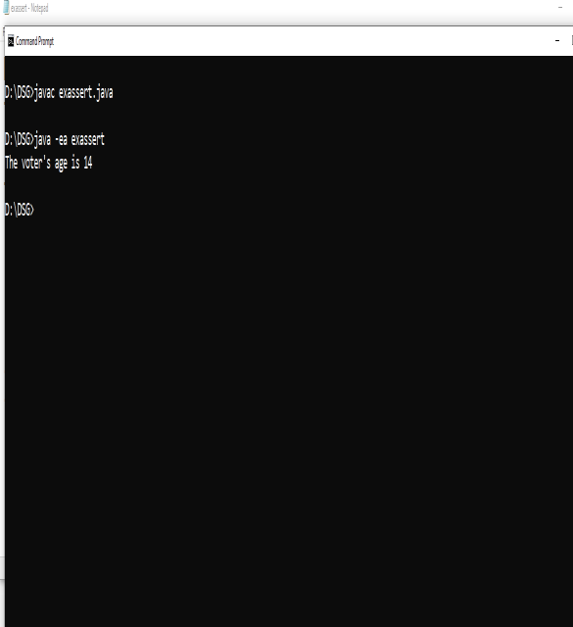
Object Oriented Programming
Dr.D.Sivaganesan and PSGiTech / CSE

Slide 15
Assertion Vs Normal Exception Handling
Assertions are mainly used to check logically impossible situations. For example, they can be used to check the state a code expects before it starts running or state after it finishes running.
Unlike normal exception/error handling, assertions are generally disabled at run- time.
Where to use Assertions
Arguments to private methods. Private arguments are provided by developer’s
code only and developer may want to check assumptions about arguments.
Conditional cases.
Conditions at the beginning of any method.
Where not to use Assertions
Assertions should not be used to replace error messages
Assertions should not be used to check arguments in the public methods as they may be provided by user. Error handling should be used to handle errors provided by user.
Assertions should not be used on command line arguments.
Object Oriented Programming
Dr.D.Sivaganesan and PSGiTech / CSE

Slide 16

Object Oriented Programming
Dr.D.Sivaganesan and PSGiTech / CSE

